Slide 1
VIRTUAL PRIVATE NETWORKS

Slide 2
Virtual Private Network
A private network is pretty obvious
An Ethernet LAN (or WLAN) running in my building
An optical fiber running between two buildings
What is a non-private network?
Someone else’s network, the Internet
What do I do if I have offices in several cities?
And people working from home
And sales people working from who knows where
Can I run my own cables around the world?

Slide 3
Virtual Private Network
A virtual private network (VPN) is a secure, private connection through a public network (or an otherwise insecure environment)
Traditionally, businesses have relied on private 56-Kbps or T-1 leased lines to connect remote offices together
Leased lines are expensive to install and maintain, for small companies, the cost is just too high
A virtual private network combines the relative low-cost of using the Internet with the privacy of a leased line
Using the Internet as a backbone, a VPN can securely and cost effectively connect all of a companies offices, telecommuters, mobile workers, customers, partners and suppliers

Slide 4
Virtual Private Network
It allows you to secure your data as it travels over an insecure network such as the Internet
VPN is designed to allow a user to access transparently the resources of a network
As far as the user is concerned, they will be able to do anything they normally would be able to do, even when they are away from the network
Because of this, VPNs are popular with telecommuters and with offices that need to share resources over physically separate locations

Slide 5
Virtual Private Network
To send sensitive organization information across the Internet in such a way as to reduce the need for leased lines and still maintain the confidentiality of the traffic, how do we separate our traffic from everyone else’s?
The short answer is that we use encryption
VPNs have several characteristics:
Traffic is encrypted so as to prevent eavesdropping
The remote site is authenticated
Multiple protocols are supported over the VPN
The connection is point to point

Slide 6
Virtual Private Network
User Authentication
VPN must be able to verify user authentication and allow only authorized users to access the network
Address Management
Assign addresses to clients and ensure that private addresses are kept private on the VPN
Data Encryption
Encrypt and decrypt the data to ensure that others do not have access to the data
Key Management
Keys, required for encryption, must be generated and refreshed for encryption at the
server and the client
Multi-protocol Support
The VPN technology must support commons protocols on the Internet such as IP, IPX etc.

Slide 7
Virtual Private Network
A well-designed VPN can greatly benefit a company
Cost Effective
Greater scalability
Improve productivity
Security
Mobility

Slide 8
Virtual Private Network
A VPN always consists of a point-to-point link known as a tunnel
Tunneling is the sending of messages of one protocol inside (that is, as the payload of) messages of another protocol, out of their usual protocol nesting sequence
The tunnel itself occurs over the insecure network which is usually an Internet connection
A point-to-point link means that it is always between two computers which are referred to as peers
Each peer is responsible for encrypting the data before it enters the tunnel and decrypting the data as it leaves the tunnel

Slide 9
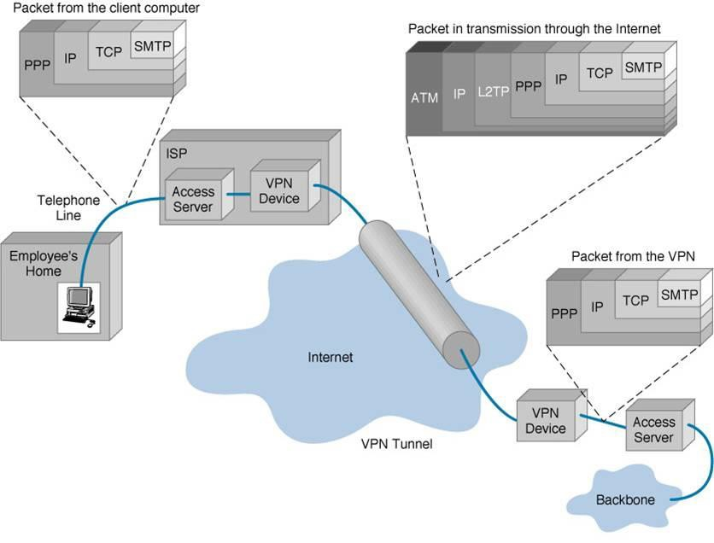
Virtual Private Network

Slide 10
Virtual Private Network
To create VPNs three concepts are used
Encapsulation (most important!!)
Encryption (Optional but provides confidentiality)
Authentication (Optional)

Slide 11
Virtual Private Network
Encapsulation
Encapsulation is the process of adding an additional header on top of data link or network layer headers
Encapsulation creates tunnels
A tunnel is a virtual path across a network that delivers packets that are encapsulated (and possibly encrypted)
Encapsulation makes inner header invisible for the public
For example, take an IP packet routed over an IPX network

Slide 12
Virtual Private Network
Encryption
Encryption provides confidentiality for VPNs
You can either encrypt payload or header + payload
Encryption uses an encryption key to scramble the data so it is non- readable
Only the intended users who posses the correct key can decrypt and read
data
Authentication
Authentication is to allow only authorized users to access the network and use resources

Slide 13
Virtual Private Network
Types of VPNs
There are two types of VPN services:
Remote Access VPN
Mobile or Home-based users can use VPNs to access the corporate network
Site to site VPN
VPN connections between fixed but geographically dispersed sites

Slide 14
Virtual Private Network
Remote-Access
Also called a Virtual Private Dial-up Network (VPDN), is a user-to-LAN connection used by a company that has employees who need to connect to the private network from various remote locations
Typically, a corporation that wishes to set up a large remote-access VPN provides some form of Internet account to their users using an Internet service provider (ISP)
The telecommuters can then reach the Internet via ISP and use their VPN client software to access the corporate network

Slide 15
Virtual Private Network
Remote-Access
A good example of a company that needs a remote-access VPN would be a large firm with hundreds of sales people in the field
Remote-access VPNs permit secure, encrypted connections between a company's private network and remote users through a third-party service provider

Slide 16
Virtual Private Network
Site-to-Site
Through the use of dedicated equipment and large-scale encryption, a company can connect multiple fixed sites over a public network such as the Internet
Each site needs only a local connection to the same public network, thereby saving money on long private leased-lines
Site-to-site VPNs can be further categorized into intranets or extranets
A site-to-site VPN built between offices of the same company is said to be an intranet VPN, while a VPN built to connect the company to its partner or customer is referred to as an extranet VPN

Slide 17
Virtual Private Network
VPN Protocols
Point-to-Point Tunneling Protocol (PPTP)
Layer 2 Tunneling Protocol (L2TP)
IPSec
PPTP and L2TP are used primarily for remote access, while IPSec is used for LAN to LAN tunneling

Slide 18
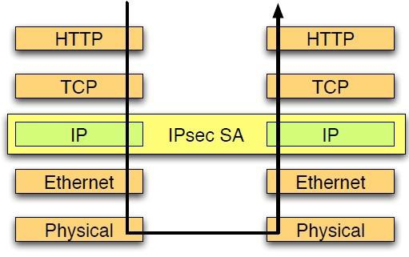
Virtual Private Network
IP Layer Security Protocol
Integrated directly into protocol stack, used to enhance IP with security
Defined as an extension to the network layer
Transparent to the above layers and application
Provides
confidentiality
integrity
authenticity
replay protection
DOS protection

Slide 19
Virtual Private Network
IP Layer Security Protocol
Consists of two protocols:
Encapsulating Security Payload (ESP)
Authentication Header (AH)
AH is used for confidentiality, ESP is used for authentication and confidentiality

Slide 20
References
Virtual Private Networks
http://en.wikipedia.org/wiki/Virtual_private_network
Security & Savings with Virtual Private Networks
http://tools.netgear.com/media/whitepapers/VPN_Security.pdf
Why you should start using Virtual Private Networks
http://lifehacker.com/5940565/why-you-should-start-using-a-vpn-and-how-to-choose-the-best-one-for- your-needs
“Network Security: A Beginner’s Guide”, by Eric Maiwald, CISSP (chapter 10)

Slide 21
THANKS

